Slide 1
Development of Advanced Materials for Radiation Detectors

Slide 2
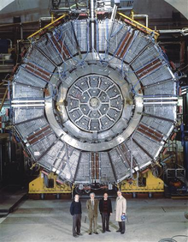
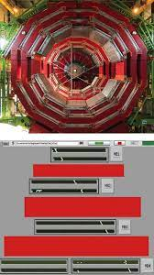
1 – What is a ”Radiation Detector”
“Radiation detector” OR “Particle Detector” (Physics Detector)
Device used to detect / track / identify Ionizing Particles
Our group historically involved in gaseous particle detectors
Townsend avalance of electrons in electric field to multiply primary electrons
E.G. Geiger-Mueller counter
Developed over ~100 years to modern particle detectors coverling large areas
Latest developments:
Triple-GEM detectors
uRWELL detectors
Aleph @ LEP 1985 -2000
CMS @ LHC 2005 - 2045

Slide 3
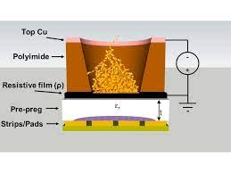
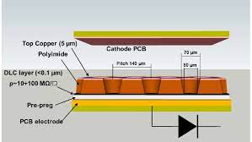
Modern Gaseous Detectors
Few detectors among the latest Developments: Triple-GEMs - uRWELL
1997
2008
Triple-GEM
2015
uRWELL

Slide 4
2 – Advanced Materials
Introduction of Resistive Electrodes / Resistive Thin Films to improve:
Spark protection (gas discharge quenching by reducing electric field)
Higher gain in single detector element => Simpler detector Structure
Better Time resolution
Main material: thin amorph carbon films (DLC)
….
Not only for gaseous detectors …
Starting era of Quantum in High-Energy physics
Main idea: deposit (Lead Halide) Perovskites (LHP) to enhance time resolution of scintillator materials Quantum Dots / Nano-crystals

Slide 5
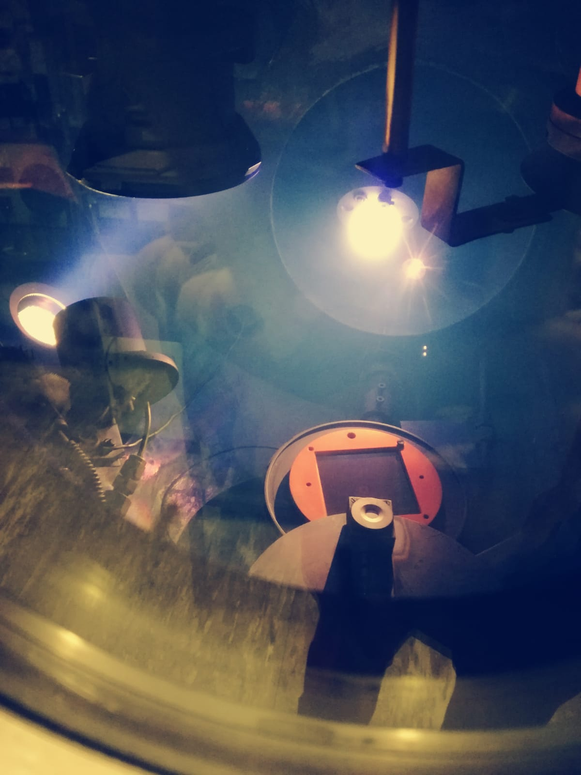
Diamond-Like Carbon – in Bari
PVD
Ion Beam Deposition setup with 2 ion sources and 1 additional source for “assistance”
setup made “in house” – vacuum vessel @ workshop – ion (Kauffman) sources bought & installed
Professor pensionned – activities on best effort – Laboratory used for didactic experiences
Higly versatile setup – very controllable – high quality films can be made with IBSD
We would be interested in the continued use of the setup / machine – reach out to Industry with IBDS (?)
AIDA Innova (EC-Funded) MS Report: https://zenodo.org/record/7690626#.ZCQbb7RByv8

Slide 6
Diamond-Like Carbon – at CERN
Rui De Oliveira – CERN Seminar - https://indico.cern.ch/event/1233427

Slide 7
Deposition techniques for Lead Halide Perovskite (LHD) nano-crystals (NC) / quantum-dots (QD)
More info on Quantum sensors for HEP: https://indico.cern.ch/event/1044975/contributions/4571178/attachments/2397990/4100432/VCI_2022_Michael_Doser.pdf

Slide 8
Also Graphene
Potential collaboration with CNR / Chemistry Department

Slide 9
Backup / Additional Slides

Slide 10
Diamond-Like Carbon – for MPGDs
2015 Pioneered by Japanese colleagues – DLC made in industry (BE-Sputter)
2017 USTC (Hefei, China) bought Magnetron Sputter setup in Laboratory
PoS TIPP2014 (2014) 351 - https://pos.sissa.it/213/351
https://indico.cern.ch/event/761831/contributions/3236762/attachments/1765980/2867435/DLC_CP_Intro_ochi_181205_v2.pdf

Slide 11
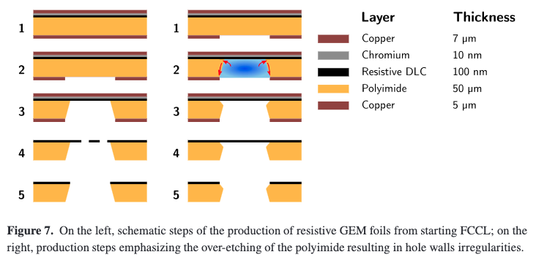
Diamond-Like Carbon – in Bari & Lecce
J.Phys.Conf.Ser. 1498 (2020) 1, 012015 - 10.1088/1742-6596/1498/1/012015
NIM A 1040 (2022) 167187 - 10.1016/j.nima.2022.167187
Had idea for development of new type of detector to improve timing
All electrodes had to be made in Diamond-Like Carbon on Polyimide
Even more … we needed layers of Cu-DLC-PI such that we can perform the various chemical Etching steps to create our detectors
BE-Sputter (Industry) provides only DLC-Polyimide
USTC (Lab / University) can make Cu-DLC-PI – but quality is not good enough
Delamination DLC – Penetration DLC with Etching liquids (ethyl-diammine & KOH) lead to irregular hole structure

